Slide 1
Zonal initiative 2019
Year 2019
Zone : Bogura
ASM: Md. Abu Taher Sarker

Slide 2
INITIATIVE WILL BE AS BELOW
DISTRIBUTOR CHANGE
DSR CHANGE
DSR REFRESHMENT
MARKET BRANDING
STICKER
RETAIL MEET
CAMPAIGN BY DISTRIBUTOR
ROUTE CHANGE OR ROUTE INCREASE
POS EXPANSION
CO EXPANSION
SBC CHANGE /DEPLOYMENT
DISTRIBUTOR HOUSE UPGRADATION
MARKET SHARE INCREASE BY YOUR INITIATIVE
DISTRIBUTOR ENGAGEMENT IN MARKET
PRODUCTS LAUNCHING BY DISTRIBUTOR
PRODUCTS TRAINING AND SALES TRAINNIG FOR DSR /SBC

Slide 3
AT A GLANCE
INITIATIVE TYPE | WHEN (MONTH /QUARTER) | WHY | OUTCOME | TOTAL COST/ SALES INCREASE
DSR CHANGE | Nov’2019 ( DSR-0706- TMSS 1st Floor) | Poor Performance | Nov’19 Sales- B:123+F:333+S:157=613 Dec’19 Sales- B:116+F:375+S:180=661 | Sales increase-7.8%
RETAIL MEET | Dec’19- New Sarker Electronics, Bogura | Increase Channel Engagement & Involvement with Symphony Yearly Credit closing & Started new business in next year. | As we faced a lot & struggled to make a good position in the market, but failed due to previous dealer’s poor management, lack of business loyalty, misbehave with retailers etc. Finally, recruiting new dealer & retail meet we got a huge positive response & Retail engagement increased unbelievable. | The event’s total cost was, 1,25,000 TK.
CAMPAIGN BY DISTRIBUTOR | Dec’2019 New Sarker Electronics : DSR incentive + Stock clearing + Route wise sales development plan. Mobile Collection & Ghori Ghor : DSR Incentive + Symphony Bijoy Offer | Extra quantity sales – 2000 pcs & Additional value sales – 35,00,000 TK. Extra basic series sales- 350 pcs. Total additional value sales-800000 TK | Result didn't come up to the mark due to bad sales scenario in Dec'19 but zonal achievement is 100% achieved. | BDT. 65,000 TK BTD. 20,000 TK
SBC CHANGE /DEPLOYMENT | Nov’19 & Dec’19 ( Dipu Mobile Center & Mobile 4U) | SBC poor performance, major violation. | Achievements of Dipu Mobile Center in Nov-87% & Dec-90% where October months were 46%. | Sales increase
STICKER | Q2 & Q3’2019 (sticker branding). | For Market visibility. | 25% tertiary sales increase from those shop. | 10,000 TK.

Slide 4
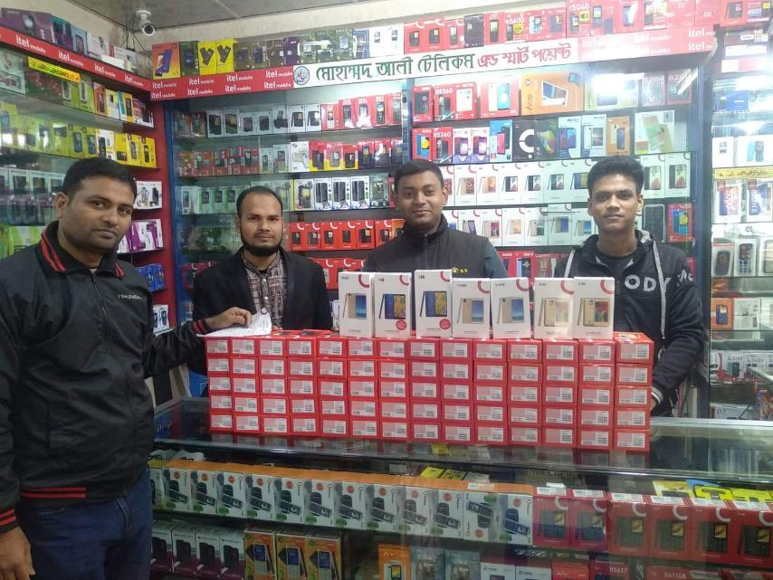
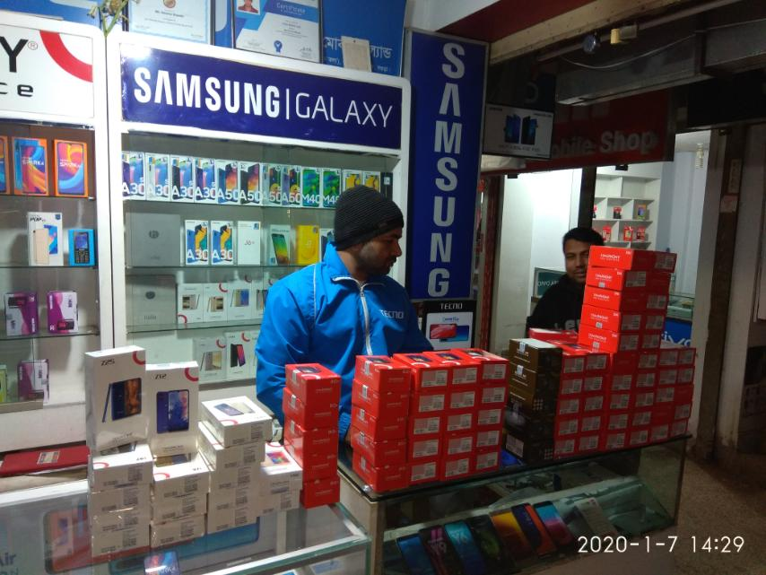
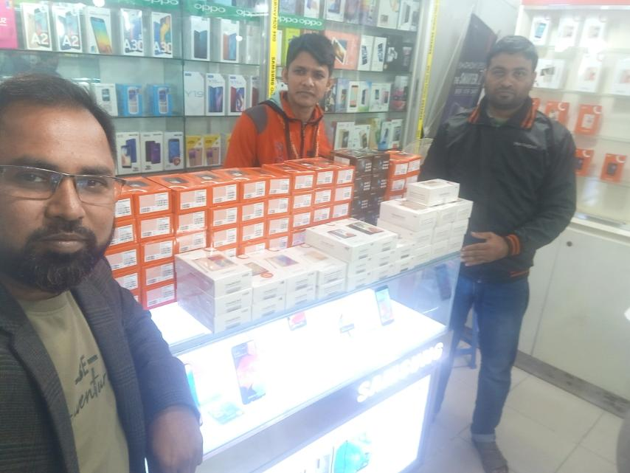
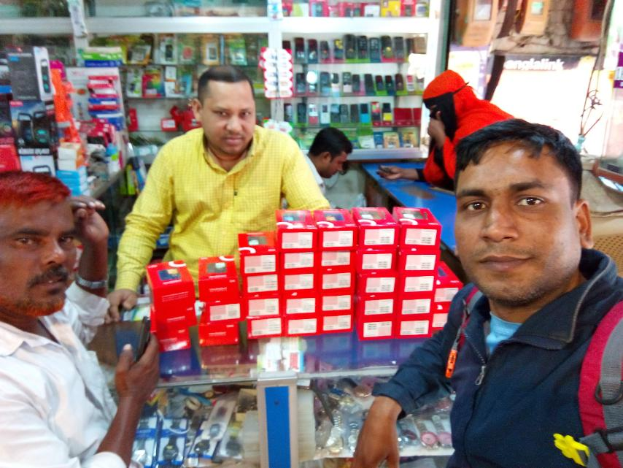
Distributor level
Initiative details
Picture : Route wise sales development plan
New Sarker Electronics:
1. Route wise sales development plan…
Retailers get 150 TK. Instant discount with 5 pcs feature phone (any model). Retailers get 80 TK. per pcs Smartphone below 5K price & 100 TK per pcs with 5K plus price.(Route: 4, Duration: 9 & 10 Dec’19)
2. Stock clearing offer…
Model: E90, V42, V46, V90, V96, V150, i15. One pcs Mug free with one pcs Smartphone. # 1500 TK. Instant discount with Z9 model. # 2000 TK. Instant discount with P9+ model. # 2500 TK. Instant discount with helio series.
3. Basic Series DSR Incentive Offer _ Dec'19 : Per pcs 3 TK.
Mobile Collection & Ghori Ghor: DSR Incentive Offer…
Feature Phone: DSR will get 3 TK. Per pcs feature Phone.
Smartphone: DSR will get 20 TK. Per pcs Smartphone.
Additional 50 TK DSR incentive per pcs V48 & V94 model.

Slide 5
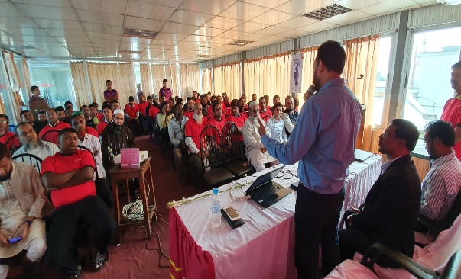
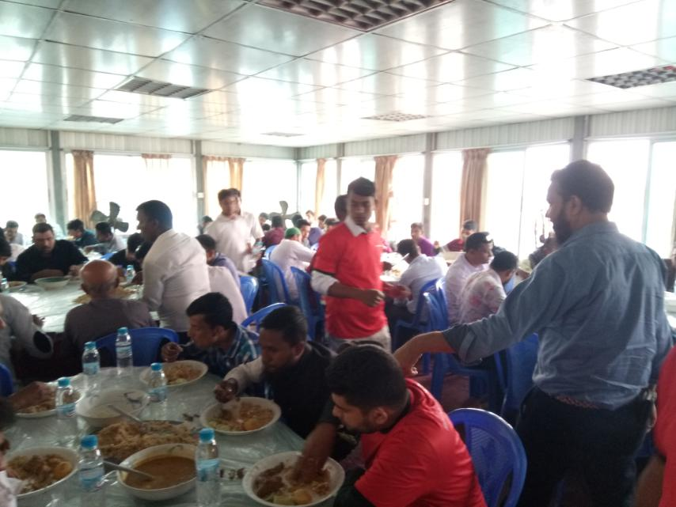
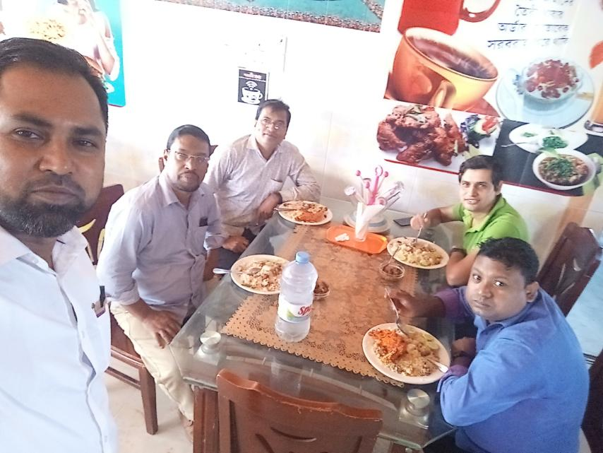
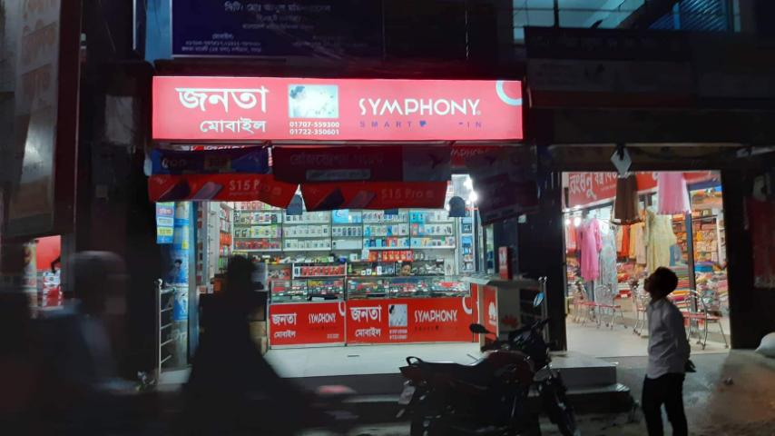
Retail level / in market/ENGAGEMENT
Initiative details
Picture /outcome
Retail Meet.
Launch with key retailers.
Retail branding has been done through distributor.

Slide 6
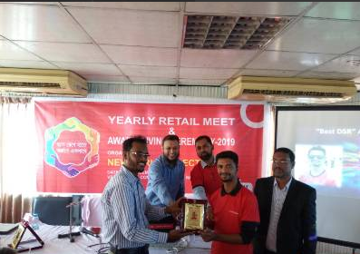
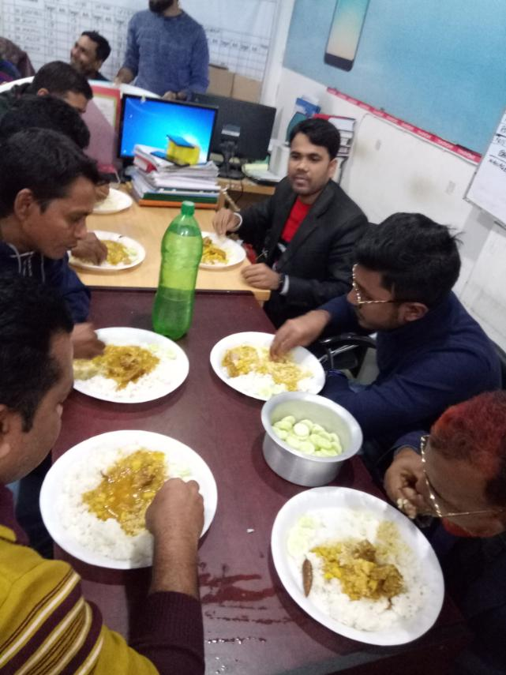
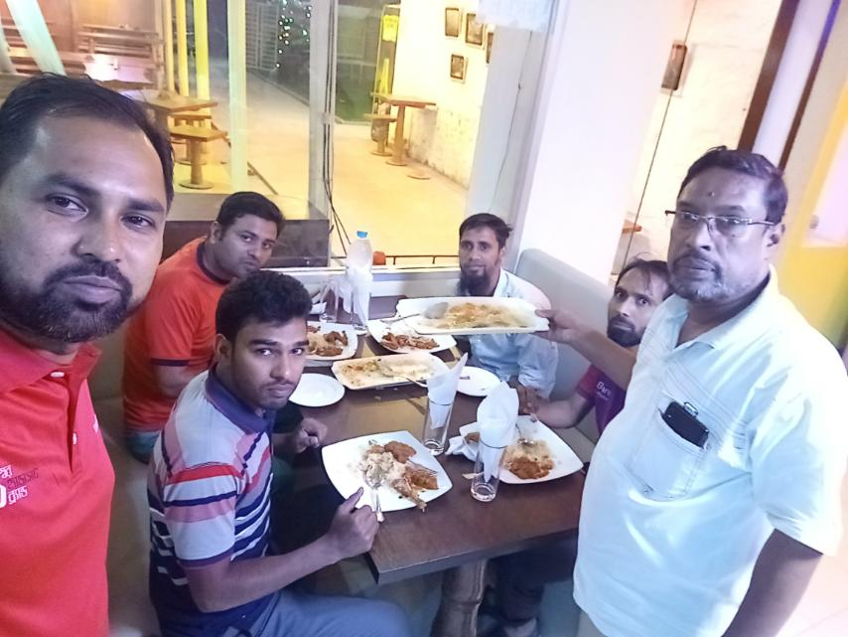
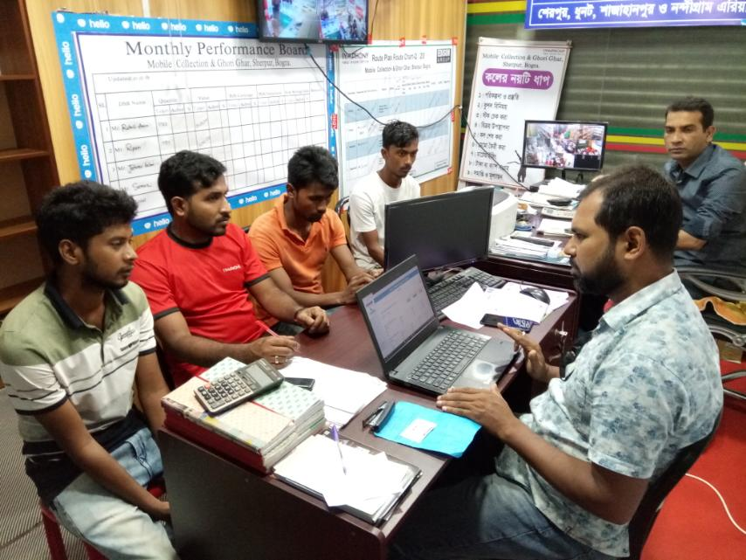
DSR DEVELOPMENT
Initiative details
Picture /outcome
Annually DSRs evaluation & arrange award ceremony.
Dinner with all DSR for sales motivation.
Regular train up of DSRs about product knowledge, Market Coverage, Product Coverage, Up-Sell, Cross-Sell, Competition knowledge etc.

Slide 7
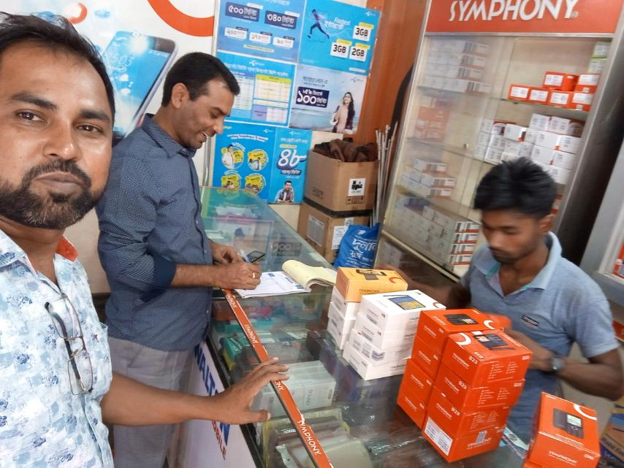
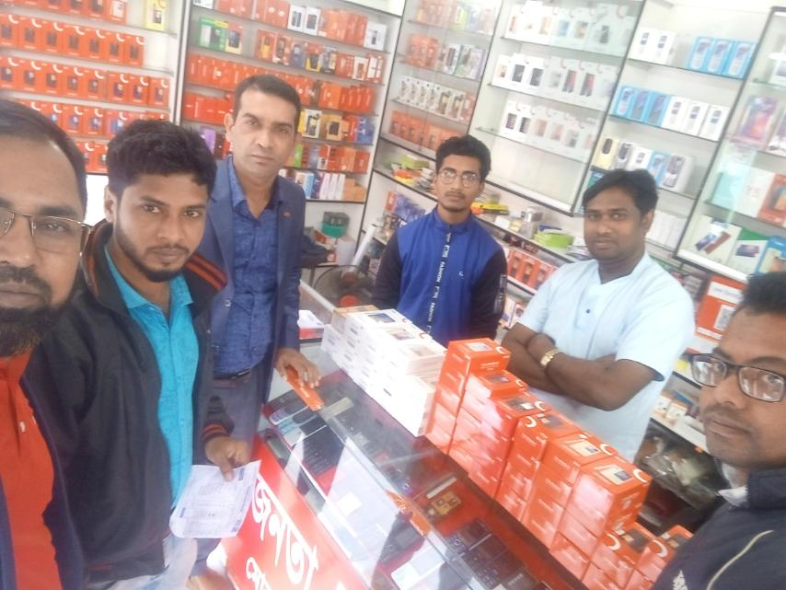
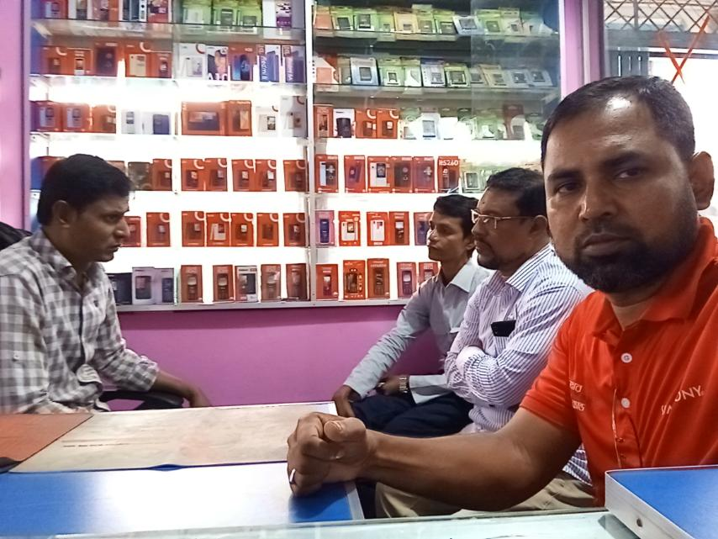
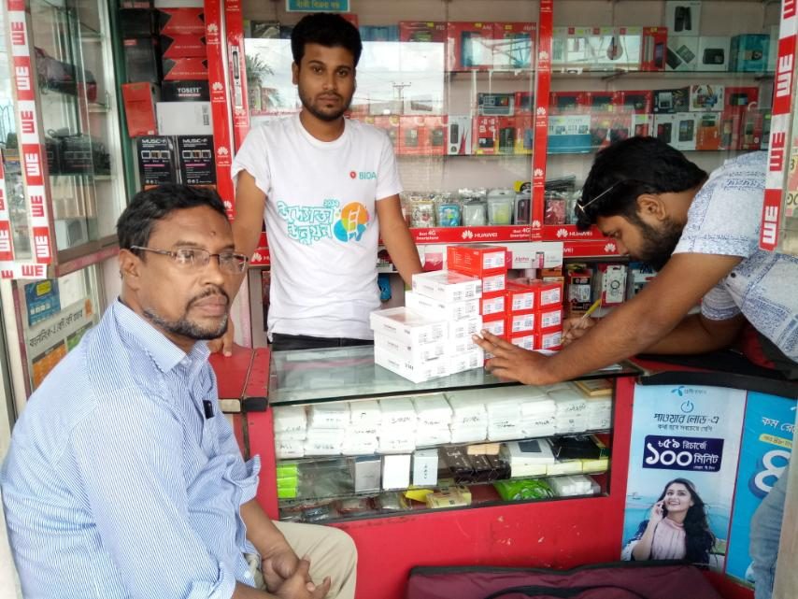
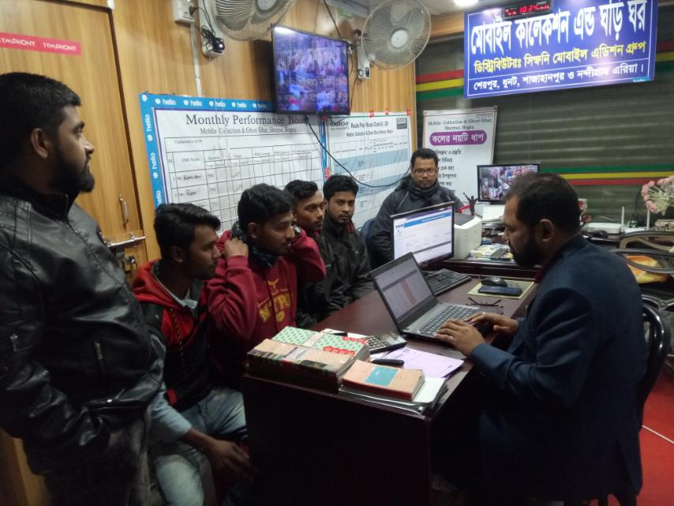
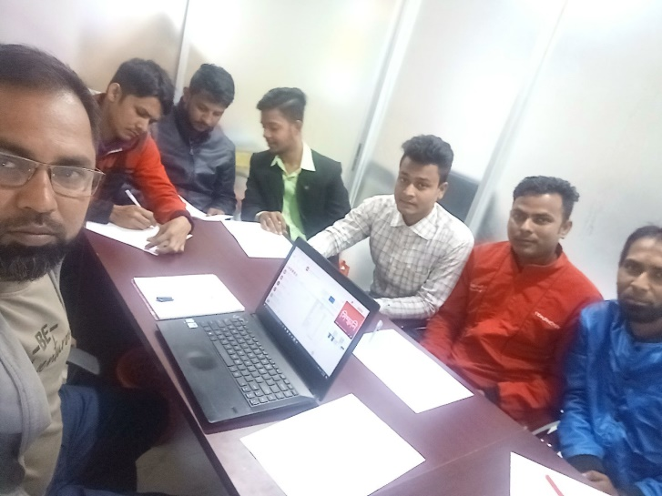
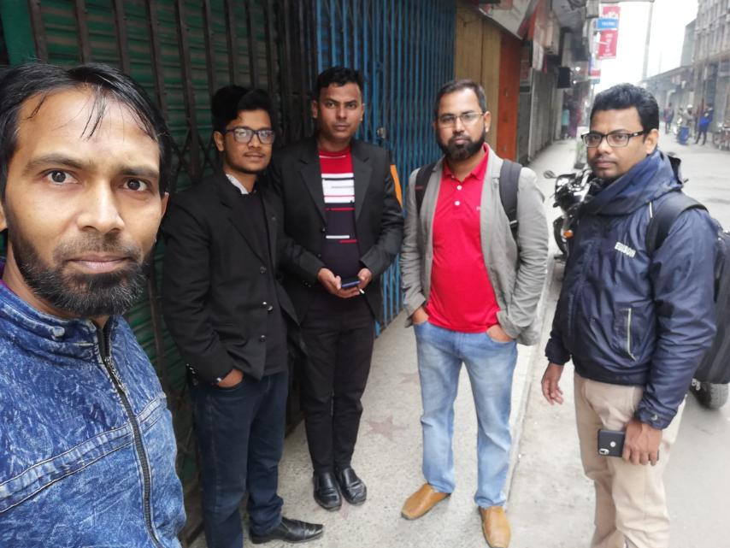
DISTRIBUTOR ENGAGEMENT IN MARKET
PRODUCTS TRAINING AND SALES TRAINNIG FOR DSR /SBC

Slide 8
Thank You!

